Slide 1
AFRICAN CONTINENTAL QUALIFICATIONS FRAMEWORK (ACQF)
7TH CONTINENTAL FORUM
28th to 30th July, 2026
Nairobi
QUALIFICATIONS AND CREDENTIALS PLATFORM(QCP) PLENARY SESSION (DAY 2)

Slide 2

QCP PLENARY SESSION
SO FROM POLICY PRACTICE
for mobility
comparability
transparency
mutual recognition
QCP CAN BE THAT PLATFORM THAT ALLOWS US TO SPEAK TO ONE ANOTHER ACROSS BORDERS
TRAIL BLAZERS
ZAMBIA-MR CALEB TEMBO
KENYA-MR HARON CHEGE
SOUTH AFRICA- MR KEORAPETSE
SEYCHELLES-MS NOELLA BAKER
BOTSWANA-OFENTSE DISANG
“Continental integration becomes real when an African an learn in one country, progress in another and work in another”. This can only be possible when pathways and outcomes are transparent, mutually recognized and easily compared, to validate competencies

Slide 3
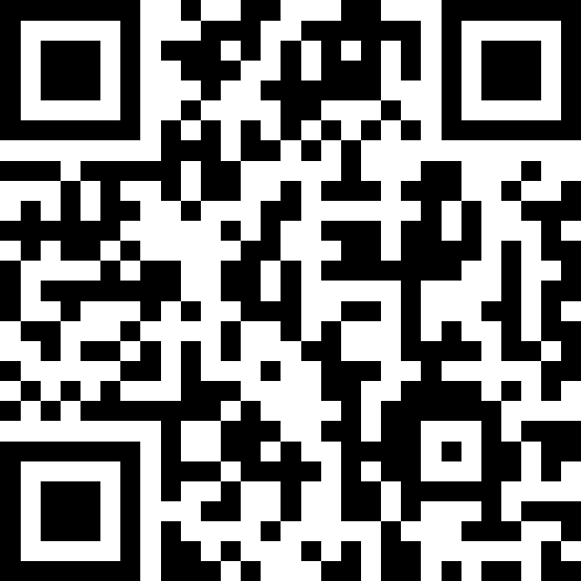

Slide 4
PLENARY QUESTIONS
HOW HAVE YOU STRUCTURED YOUR QCP WORK INSTITUTIONALLY?
WHAT WERE THE MAIN OBSTACLES THAT YOU FACED, AND HOW WERE THEY OVERCAME?
HOW ARE YOU EMBEDDING QCP ACTIVITIES IN YOUR DAY TO DAY OPERATIONS?
HOW DO YOU PLAN TO SUSTAIN THIS EFFORT BEYOND THE CURRENT PROJECT PHASE?

Slide 5
THANK YOU!
MERCI!
OBRIGADO!
ASANTE SANA!

